Slide 1

THE PATH TO AI & DATA DRIVEN STRATEGY for
IMT 580 Final Group Presentation
Group 1 -
Juntong Wu, Siddharth Purohit, Sophie Deng, Vanshika Srivastava,

Slide 2
For years, LinkedIn has been at the cutting edge of AI and data, which have become its core differentiating competencies.
Data products of LinkedIn include but are not limited to skill endorsement, news feed, and personalized recommendation. With explainable AI system, LinkedIn is helping the sales team to trust AI and identify the best solutions.
Bias, stereotypes, and discriminations are deep-rooted problems brought by algorithms. At the same time, LinkedIn seems to care less about the underprivileged employees.
From audio/video integration and the AI Academy, we see the growing opportunities for LinkedIn in the next 5 years.
Data security, misinformation, political governance, and malicious contents are common threats for tech companies including LinkedIn.
We have made two major recommendations for LinkedIn that concerns inclusiveness and tackling bias in AI.
Executive summary

Slide 3
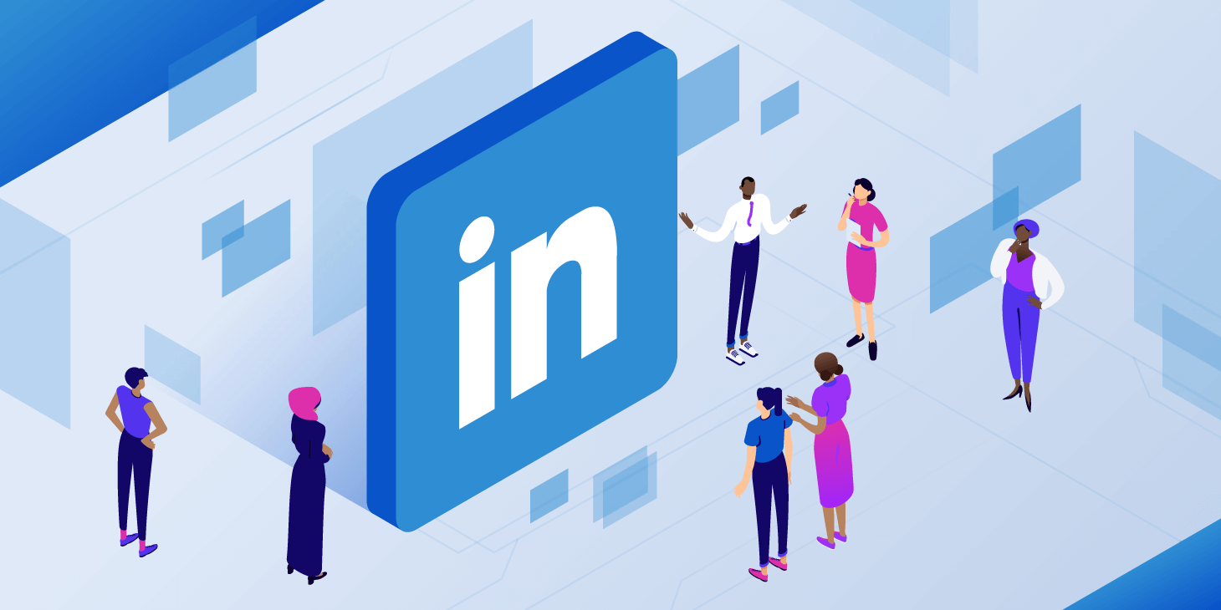
Table of contents
recommendations
Overview
Strengths powered by AI and Data analytics
Problem Analysis
Future Scope of LinkedIn
Threats to be addressed
Recommendations

Slide 4

overview
Brief introduction of the organization

Slide 5
overview
Launched in 2002
Professional networking
Job postings
Linkedin Learning
Social networking platform specifically for the business community
Users create profiles, in which they summarize their careers, skills, and employment history.
Employers publish job postings and search for potential candidates
A platform for online learning that enables users to gain skills to advance their careers

Slide 6
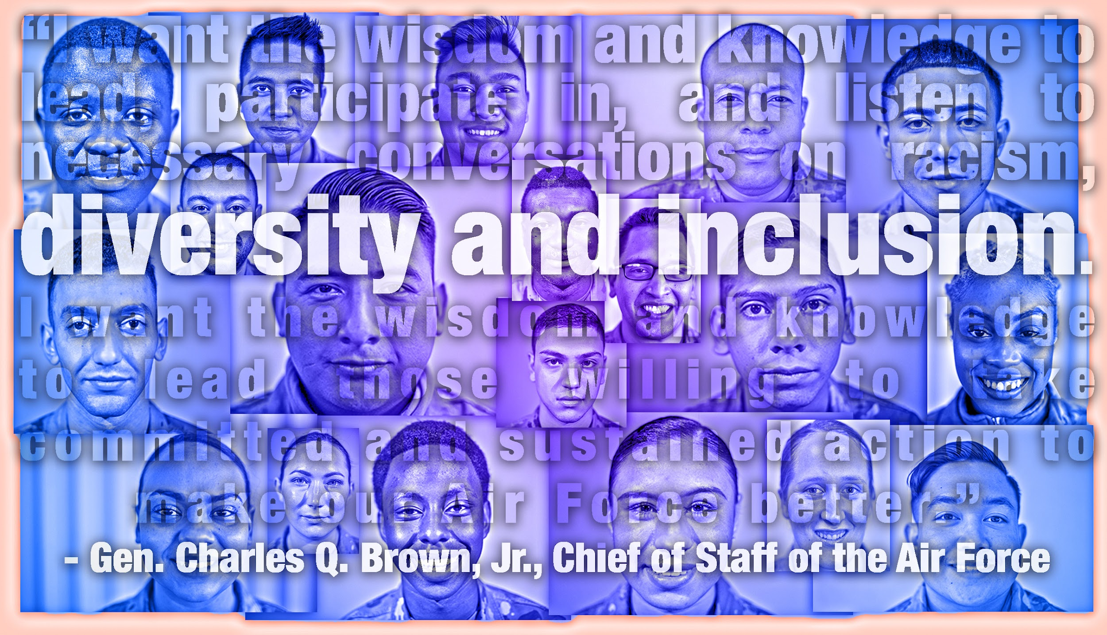


shared values and vision
Diversity, inclusion and belonging
Honest and constructive learning
Prioritizing people

Slide 7
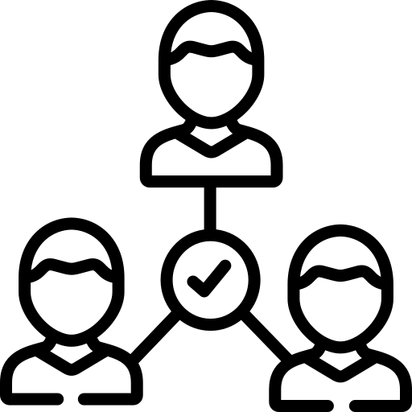

Why this topic?
Familiarity with Linkedin
AI/Data Science
Regular users of Linkedin
Networking, internship/job search, and learning new skills
Cutting edge uses of AI
Opportunity for strategic learning
Explore practical Data Science applications.

Slide 8
Our scope
recommendation systems
Data & Analytics
We examine two in-depth case studies that show how LinkedIn leverages AI to grow.
Transparent, responsible and explainable systems for matching candidates with jobs, and vice versa
Data products used at Linkedin such as news feed updates and Linkedin Knowledge Graphs to analyze member data

Slide 9
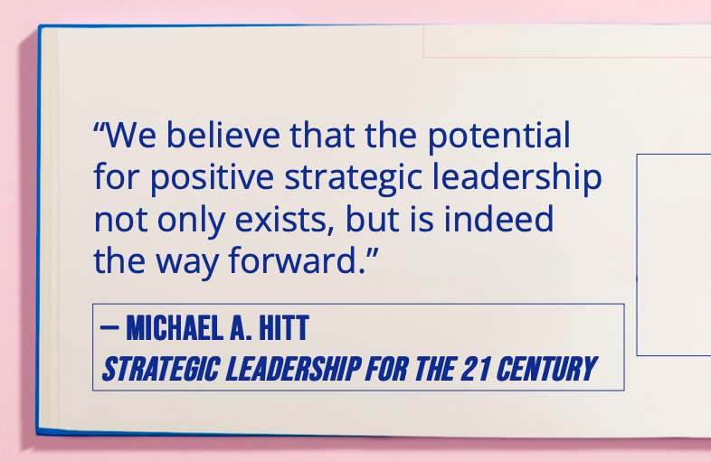
Strategic leadership capabilities of LinkedIn
DYNAMIC CORE COMPETENCIES
Emphasize human capital
AI & big data analytics are core differentiating competencies of LinkedIn
Linkedin prioritizes their employees' productivity and success across all kinds of decision-making.

Slide 10
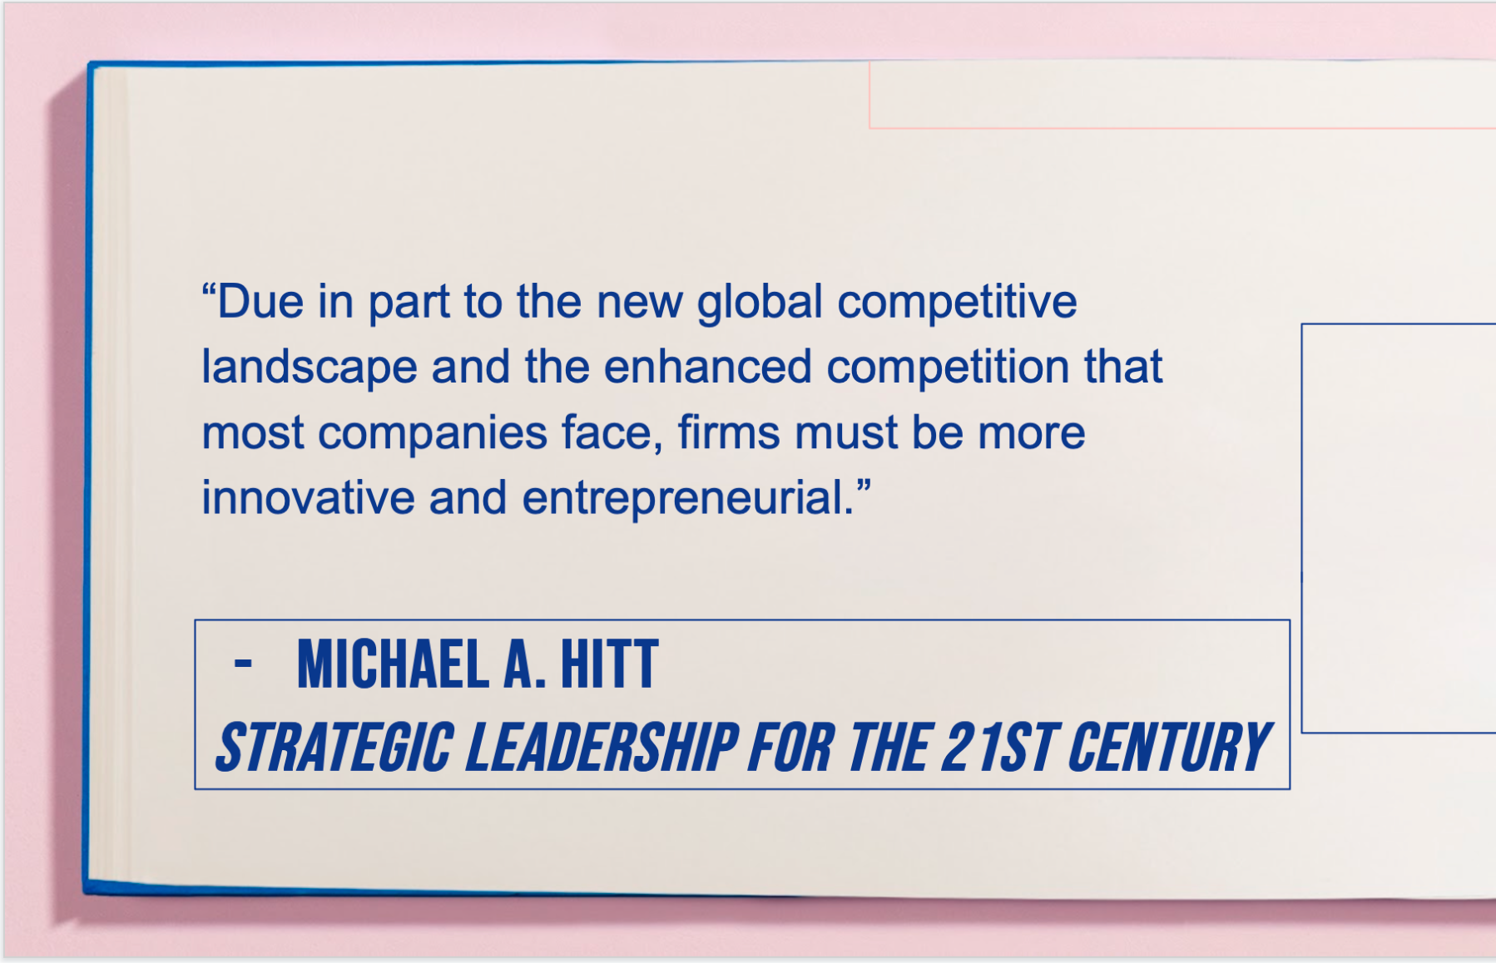
Strategic leadership capabilities of LinkedIn
Invest in the development of new technologies
Develop and communicate a vision
Linkedin invests heavily in developing disruptive tech such as explainable AI and knowledge graphs
Linkedin’s Vision : Create economic opportunity for every member of the global workforce

Slide 11
01
strengths
Data and AI power everything in LinkedIn

Slide 12


#1 DaTA & Analytics
Data Products used at LinkedIn :
Skill endorsements:
Data gathering and analytics are used to extract expertise based right candidates
News feed updates:
Uses ML algorithms of Hadoop for new and relevant updates

Slide 13
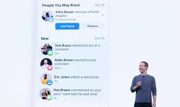

Data Products used at LinkedIn :
People recommendations:
Uses Hadoop batch processing to filter online and offline data to provide recommendation to connect on LinkedIn.
Jobs you may be interested in:
Uses data to help recruiters with searchable job titles and skill sets.

Slide 14
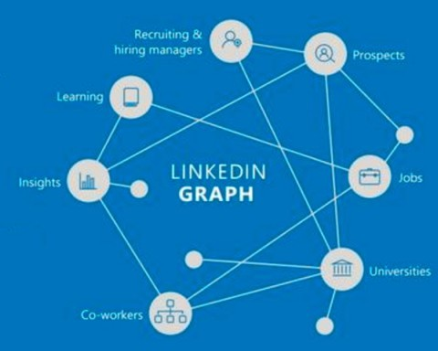
LinkedIn Knowledge Graph to analyze member data :
LKG is a large knowledge base that uses entities like members, jobs, titles, skills, companies, locations, schools etc.

Slide 15
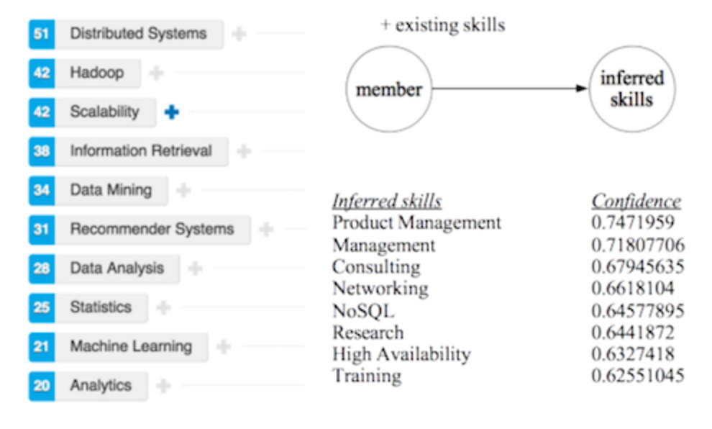
LinkedIn Knowledge Graph to analyze member data :
Data and ML models are used to help with features like ranking search results, ads and updates in news feed to enhance monetization, business and consumer analytics.

Slide 16
#2 artificial intelligence
Explainable AI (XAI)
HOW
WHAT
WHERE
WHY
How a model is trained and evaluated
What inputs go into the model
Where are the decision boundaries of the model
Why a specific prediction are made by the model
Notes:
When we talk about AI and data, they go hand in hand with each other: the relationship is like: Data is ingredients, AI is the recipe.
When you try baking for the first time, you get fully confident while purchasing the ingredients, but when you back home and open the recipe book, you may find them too boring and difficult to follow.
So we should not be satisfied with creating as many as luxurious recipes alone, but empowering an amateaur the ability to cook the best food out of their own.
As of LinkedIn, we believe it is on the right track to break the barrier between AI machine and human brains.
Explainable AI.
Four metrics define what XAI is: how what where why
By elucidating them, even a layman can trust and use AI.

Slide 17
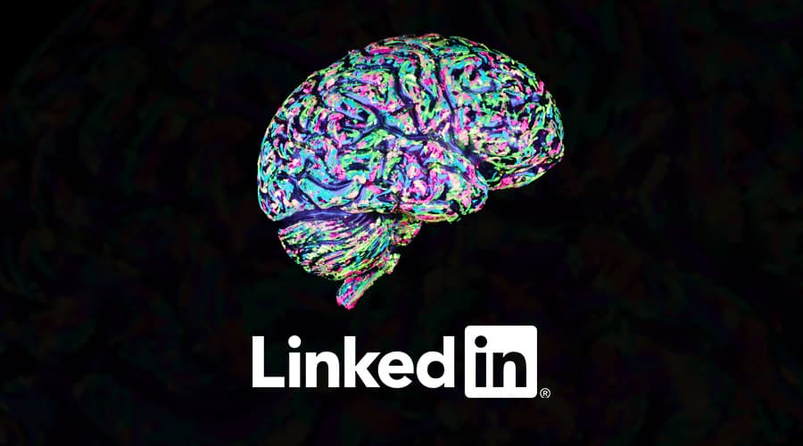
Case study
AI-driven recommendation system to help scale sales efficiency across LinkedIn
Key question:
How can AI help the sales team effectively identify the best LinkedIn solutions to fit customers’ needs in a scalable and accurate manner?
Solution:
CrystalCandle
Notes:
Scenario: When sales are presented with model scores, they wanted to understand the underlying reasons behind the them—such as why the score was higher for Customer A but lower for Customer B—and they also wanted to be able to double check the reasoning with their domain knowledge.

Slide 18
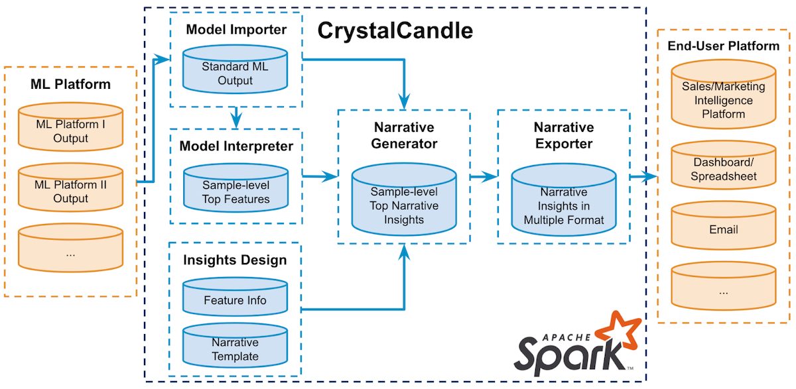
CrystalCandle: a user-facing model explainer
Narrative generator
Model interpreter
Apache spark
Provide users with an interface for customizing narrative insights
Generate important feature list and provide users with an interface for implementing model interpretation approaches
The entire CrystalCandle is built on Apache Spark to achieve high computational efficiency
Notes:
Through model interpreter and narrative generator, an interface is generated to present insights.

Slide 19
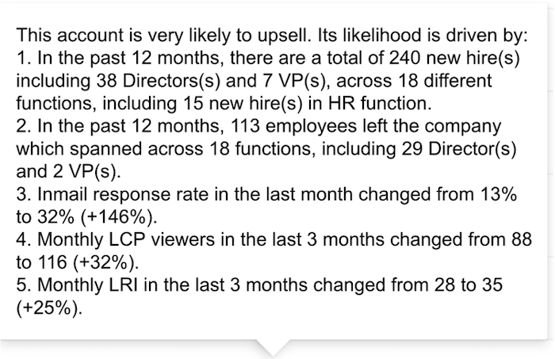
The output of CrystalCandle
The output of CrystalCandle is a list of top narrative insights for each customer account, which reflects the rationale behind the ML-model provided scores.
Notes:
These narrative insights are much more user-friendly, bring important metrics to sales representatives’ attention, and are clear and concise. These narratives give more support for sales teams to trust the prediction results and better extract meaningful insights.

Slide 20
02
Weaknesses
What problems does LinkedIn face?

Slide 21

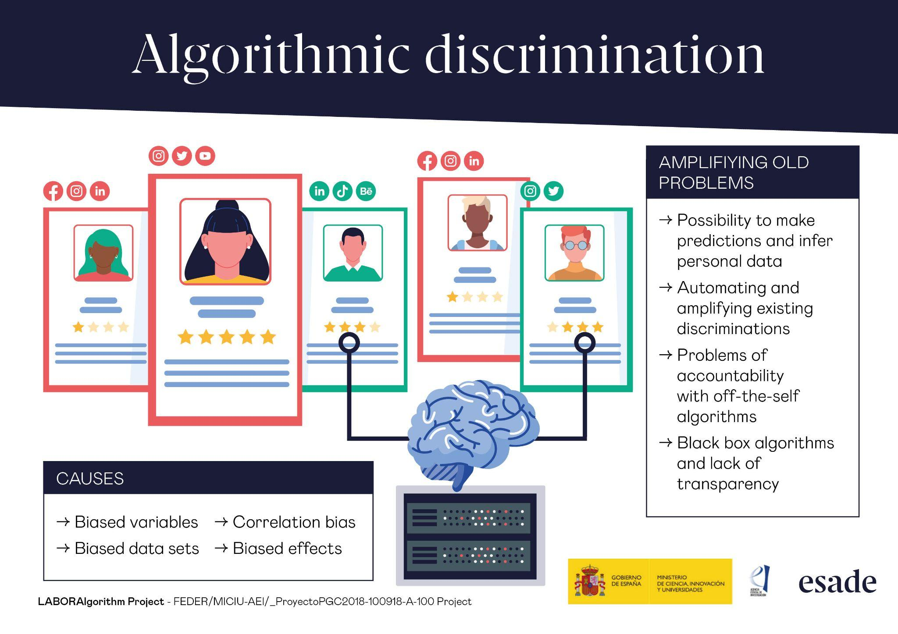
Bias, stereotypes, discrimination in algorithms
You are defined by algorithms:
Qualifications
Skills
Experiences
Algorithms are all about optimization.
What problems can this bring about?
Notes:
As for weaknesses, we know there are probably in many aspects, but today What our group want to emphasize today is its ethical problems, especially under the context of the use of Artificial Intelligence. You can think of this question: what is the essence of algorithms? Well, from a technological and management perspective, algorithms are all about optimization. It computes the largest possibility, and it transfer theoretical and statistical meanings to a real-world solutions. Using LinkedIn as an example, you are scored by your educational background, your experiences, gender, citizenship, etc., and LinkedIn matches you with possible jobs and employees. Some people may say that this is exactly how the actual world works, because in real life, you are scored under those factors, too! However, things can get tricky when machines do some jobs.

Slide 22
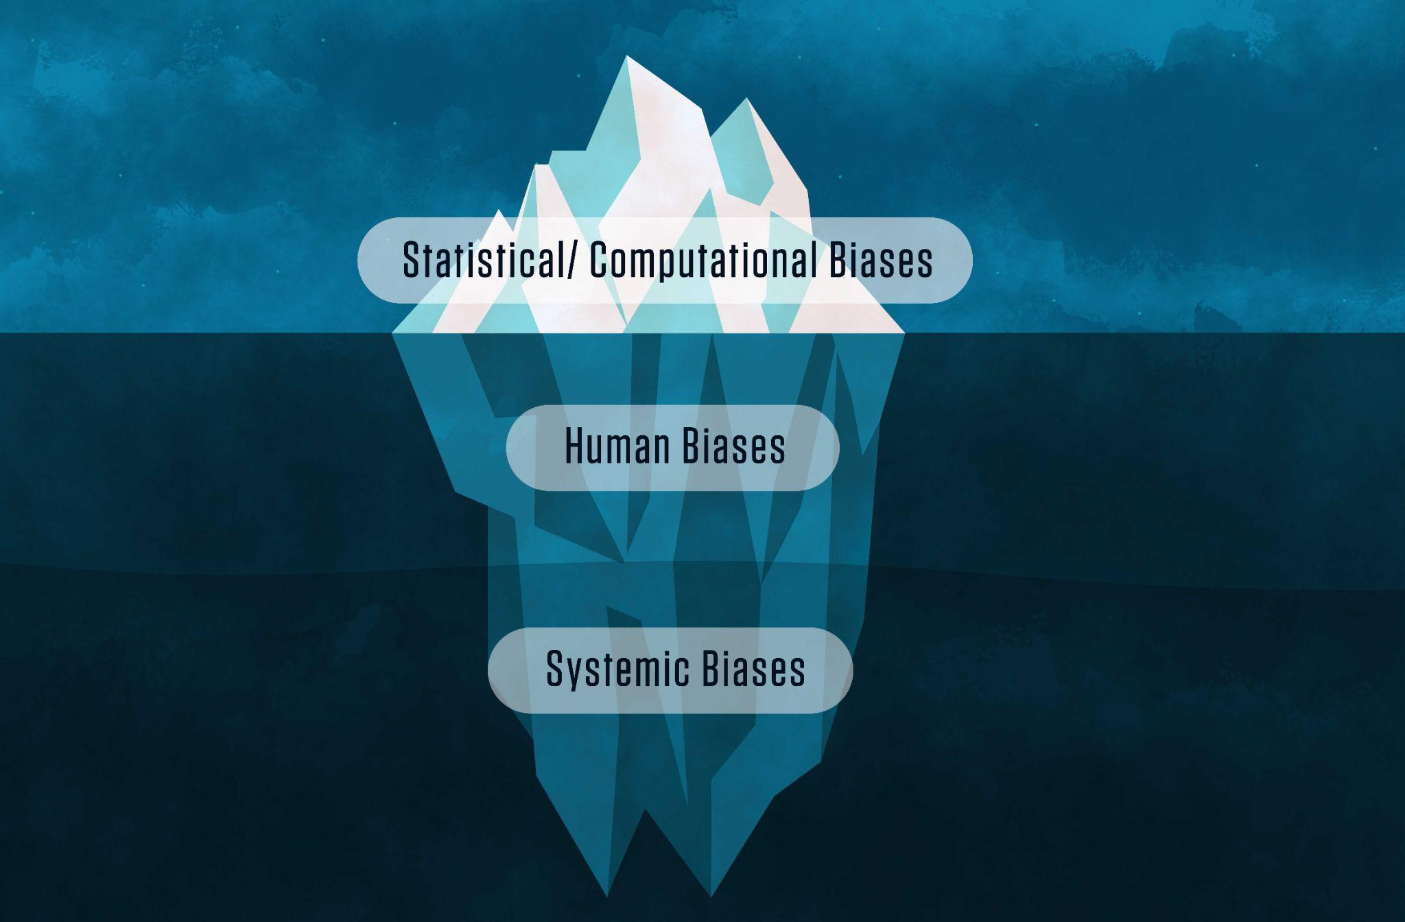
Bias in artificial intelligence
AI looks for patterns, statistical data and trends. This can lead to bias when pervasive societal and cultural inequality impact that data.
Case: recommendation systems
Notes:
Lets’ see a specific example here. Once upon a time, the LinkedIn algorithm was ranking the candidates based on how likely they might apply for a position or respond to a recruiter. It turns out, due to gender characteristics, women are not as aggressive and bold as men to apply for jobs. With this dataset as training data, holding all the other variables constant, female candidate is ranked behind male candidates.

Slide 23
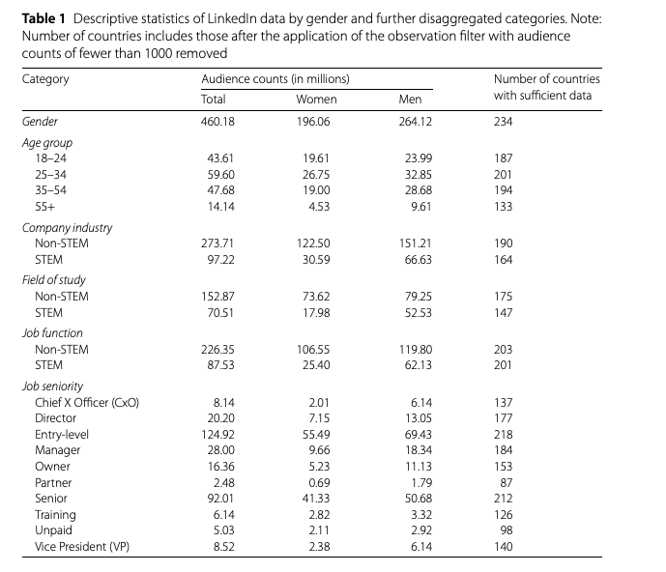
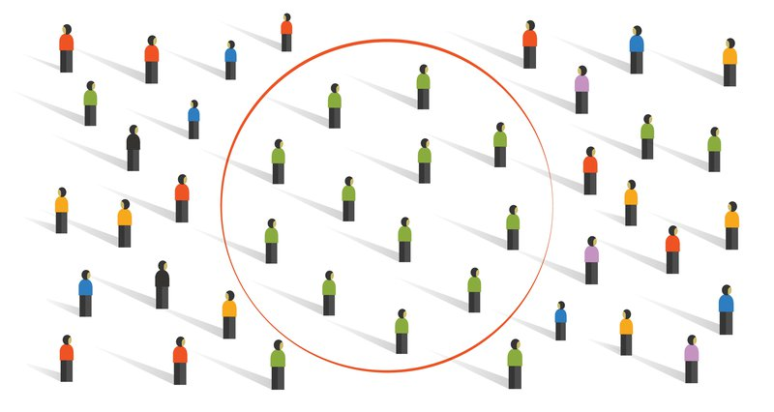
Notes:
There’s huge selection bias or sample bias in the initial model training process . For example, here is a graph of some descriptive statistics about linkedin users. Keep in in mind that all the data scientis machine learning engineers, they are developing models based on this exact datta, and this can create bias. Bias can be standaized ,programmed and justified in the name of corporate efficiency and technological progress. This is somethings we must be cautious about.

Slide 24
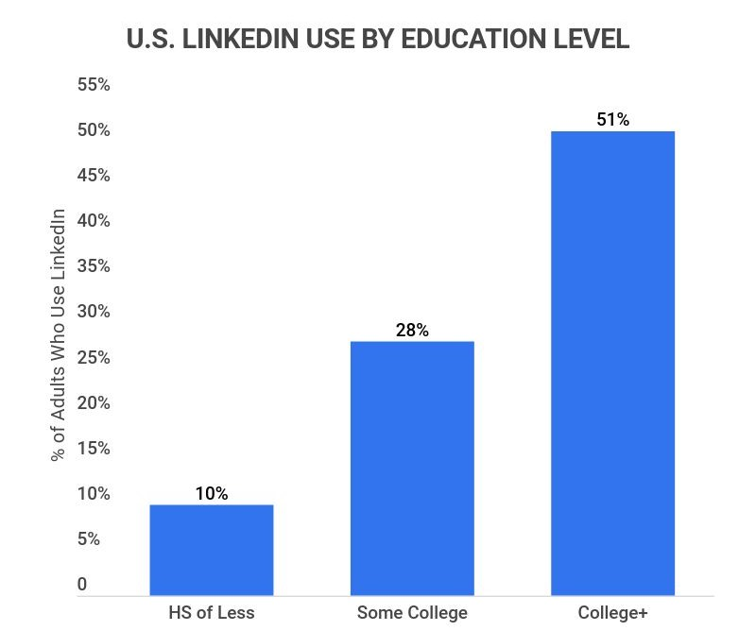
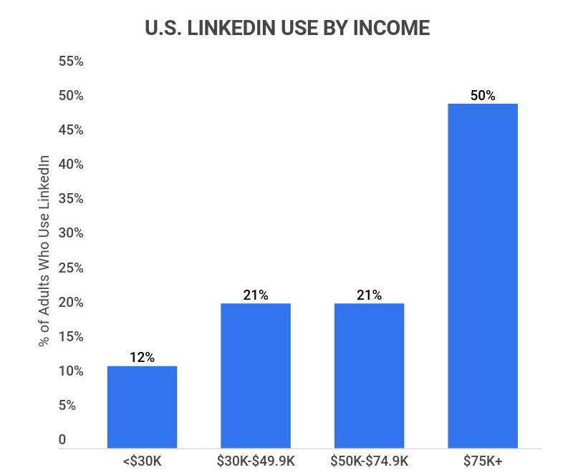
Labor Gap
Notes:
Netx. Another problem would be the huge labor gap. Some statistics of linkedin members give us pictures of what group of people are using this platform. We can see that generally speaking, their users are educated with relative high income.

Slide 25
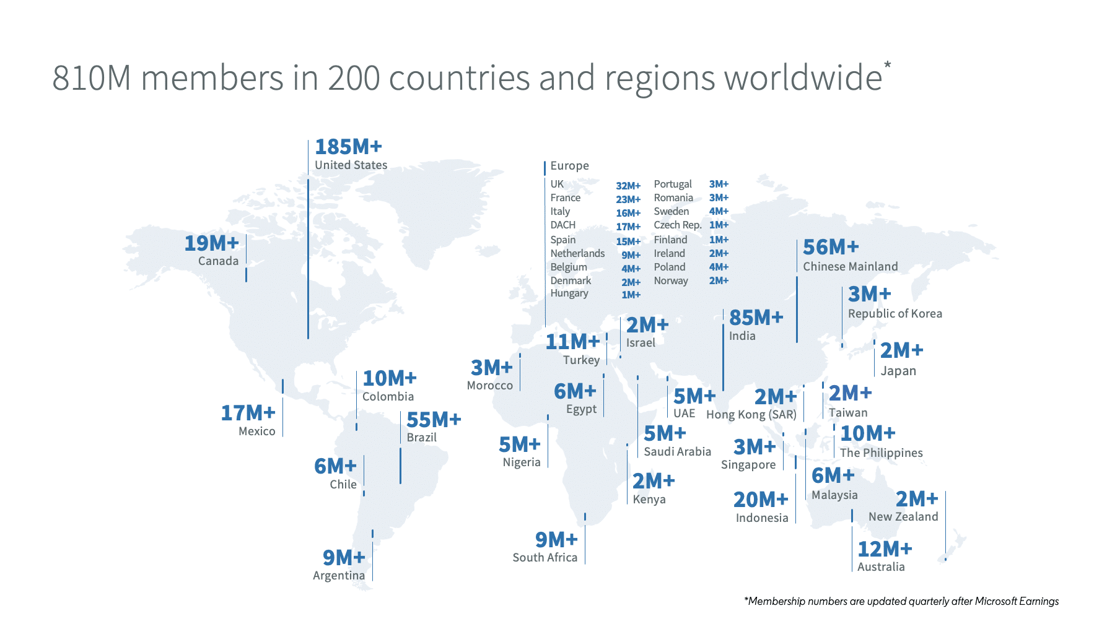
Notes:
Linkedin ‘s official vision is to create economic opportunity for every member of the global workforce. As we can see in this picture, its distribution is pretty uneven. I’m china, I can guarantee most of people never heard of this platform not to mention using it to find jobs.

Slide 26

Social Responsibility: Is LinkedIn helpful for the less privileged?
A possible active LinkedIn member:
Advanced Degrees
Developed Countries
Middle-Class Families
Business impact？
Notes:
So here is my question, who do you think has the greater need in finding a job ? Is it people with fancy degrees, lot of experiences, or is it people who are working as blue collar workers, who are less educated, less privileged? This may not be a fair question, since the gap between workers, this is the reality, we must admit it . But we say so many times that information is changing our society, and that internet is revolutionzing our way of living, can we really say so if the sacriice is bigger gap between the privileged and the less privileged? Inernet is not utopia, but we do have hopes for it, that is to push fairness, transparency. We want it to be less centralized, and we want every person can benefit from progress. Specifically in this case , we ‘d like to see more oppportulities for the less educated people in Linkedin. This is not just from the perspective of corporate social responsibility, I bet there are economic values too. Those are the problems we want everyone to think about.

Slide 27
03
opportunities
What LinkedIn can do in next 5 years?

Slide 28


Audio/video integration
AI systems can learn from the content shared over audio/video
GOAL: Build ML model to identify and store keywords and skill requirements asked in an interview to help map other job seekers with the right job roles

Slide 29
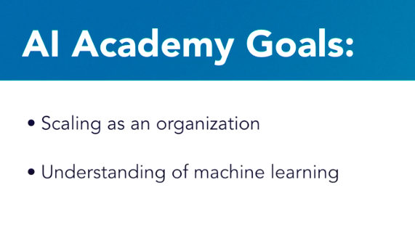
Linkedin AI ACADEMY
Bolster internal AI skills for human capital
GOAL: to equip employees across the company—in areas like engineering, product management, etc.—with the knowledge they need to optimally deliver impactful AI experiences to all members.
Notes:
Another opportunity lies in the AI academy. While modern computing resources have enabled an exponential increase in the amount of AI we can implement, the number of people with expertise in AI has not scaled at the same rate.
The purpose of AI Academy will give all of our our employees a language in common with our AI specialists, facilitating further collaboration, and will allow us to continue increasing the value we provide our members.
We believe future success with the AI Academy looks like every engineer, product manager, and other employee at LinkedIn knowing the optimal amount about AI for their job. Our goal is to scale AI across all of LinkedIn.
https://engineering.linkedin.com/blog/2018/05/the-ai-academy--how-were-scaling-ai-across-linkedin

Slide 30
04
THREATS
What challenges does LinkedIn currently needs to address?

Slide 31
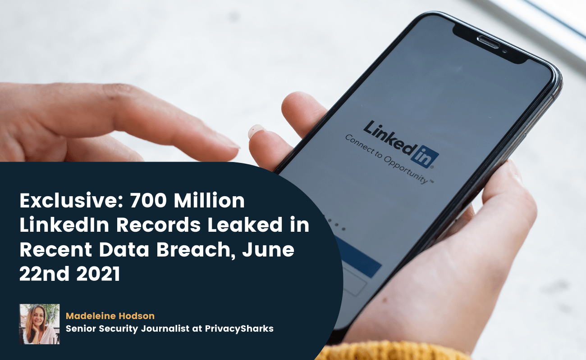
challenges
Data security:
Frauds, scams, phishing, data leakage
Misinformation:
Fake profiles
Notes:
Now Let’s have a quick look at the threats and challenges linkedin is faced with. Basically, it has data security issues, and misinformation. Last year, it was reported that over 7 million user data was leaked. This kind of scandal harms its reputation.

Slide 32
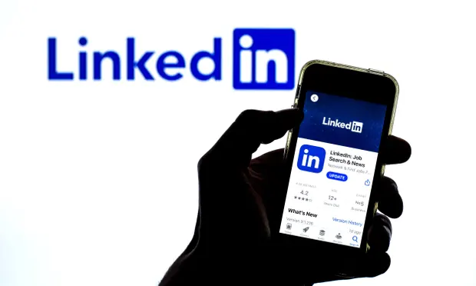
challenges
Political governance:
Banned or strictly regulated in some countries
Malicious content:
Abuses, discrimination, recism, terrorism
Notes:
What’s more, as an international company, its development is hindered by some geopolitical regulations. For example, some of its product features are shut down in China, due to government policies. Also as a platform where users are able to create content, it has some malicious content, which causes serious problems for its users. Those are the things linkedin needs to handle in its future development.

Slide 33
05
Recommendations
For a better future for LinkedIn

Slide 34

Making linkedin more inclusive
Separate keyword tag that help distinguish blue-collared and white-collared jobs on the platform.
Establishing a minimum pay scale criteria on job postings to eliminate labor exploitation.
Creating a platform for underskilled workers to be mentored by skilled professionals, enabling them to enhance their expertise and interview skills.
Notes:
Helps blue collar workers become more visible to recruiters, will help them generate more job opportunities
Recruiters can fill existing labor shortages, more convenient for them as they are already familiar with hiring through linkedin

Slide 35

Tackling bias in Ai
Setting different decision thresholds for different groups of users
Establish processes and practices to test for and mitigate bias in Al systems
Before executing an algorithm, developers should make initial assumptions about its purpose and account for biases where appropriate.
Notes:
Using internal third parties for auditing data and models

Slide 36
References
Agarwal, D. (n.d.). An introduction to AI at linkedIn. LinkedIn Engineering. Retrieved October 27, 2022, from https://engineering.linkedin.com/blog/2018/10/an-introduction-to-ai-at-linkedin
Babi, J. (n.d.). LinkedIn - ai helps companies and professionals find each other faster. Digital Innovation and Transformation. Retrieved October 27, 2022, from https://d3.harvard.edu/platform-digit/submission/linkedin-ai-helps-companies-and-professionals- find-each-other-faster/
Gareth R. Jones & Jennifer M. George. (2014). Contemporary Management, McGraw-Hill Education.
Hitt, M. A., Haynes, K. T., & Serpa, R. (2010). Strategic Leadership for the 21 Century. Business Horizons, 53, 437–444.
LinkedIn | Overview, History, & Facts. (n.d.). Encyclopedia Britannica. Retrieved October 27, 2022, from https://www.britannica.com/topic/LinkedIn
Walch, K. (2020, July 2). How AI is impacting operations at linkedin. Forbes. Retrieved October 27, 2022, from https://www.forbes.com/sites/cognitiveworld/2020/07/02/how-ai-is-impacting-operations-at-link edin/?sh=1f042c523a48
Bishop, T. (2021, July 28). LinkedIn posts first $10 billion year, 5 years after Microsoft deal, but profits remain a mystery &ndash; GeekWire. GeekWire. Retrieved October 28, 2022, from https://www.geekwire.com/2021/linkedin-posts-first-10-billion-year-5-years-microsoft-deal-profi ts-remain-mystery/
A Case Study on LinkedIn - Leveraging Big Data Analytics. (2022, April 12). JIMS Kalkaji. Retrieved December 1, 2022, from https://www.jagannath.org/blog/information-technology/a-case-study-on-linkedin-leveraging-big-data-analytics/
Tackling bias in artificial intelligence (and in humans). (n.d.). McKinsey & Company. Retrieved December 1, 2022, from https://www.mckinsey.com/featured-insights/artificial-intelligence/tackling-bias-in-artificial-intelligence-and-in-humans
Lee, Paul Resnick, and Genie Barton, N. T. (2019, May 22). Algorithmic bias detection and mitigation: Best practices and policies to reduce consumer harms. Brookings. Retrieved December 1, 2022, from https://www.brookings.edu/research/algorithmic-bias-detection-and-mitigation-best-practices-and-policies-to-reduce-consumer-harms/
Martell, C. (2018, May 16). The AI Academy: How We’re Scaling AI Across LinkedIn. https://engineering.linkedin.com/blog/2018/05/the-ai-academy--how-were-scaling-ai-across-linkedin
Yang, J. (2022, Apr 6). The journey to build an explainable AI-driven recommendation system to help scale sales efficiency across. LinkedIn. https://engineering.linkedin.com/blog/2022/the-journey-to-build-an-explainable-ai-driven-recommendation-sys
Culture and Values. (n.d.). LinkedIn Careers. Retrieved December 2, 2022, from https://careers.linkedin.com/culture-and-values
How LinkedIn Uses Machine Learning to Analyze Member Data. (2016, December 7). LinkedIn. Retrieved December 2, 2022, from https://www.linkedin.com/pulse/revealing-true-value-linkedin-data-margaretta-colangelo/

Slide 37
THANKS!
Do you have any questions?
Please keep this slide for attribution

